Slide 1
Problem statement : Plagiarism checker
Team Name : Code-Geass
Team No : College Name : Panimalar Engineering College

Slide 2
Team members Name | Mail id | Team faculty mentors | Mail id
Neeraj J V | jvneeraj10000@gmail.com | Dr. S. Hemamalini | s.hemamalini.pec@gmail.com
Padmesh J | padmeshjothi70@gmail.com | Dr. S. Hemamalini | s.hemamalini.pec@gmail.com
G. Naren Shailesh | narenshailesh913@gmail.com | Dr. S. Hemamalini | s.hemamalini.pec@gmail.com
A. Santhosh | santhoshtheking123321@gmail.com | Dr. S. Hemamalini | s.hemamalini.pec@gmail.com
Team details
Team Name – Code-Geass Team No - College Name - Panimalar Engineering College

Slide 3
PROBLEM STATEMENT DETAILING
To create a set of tools to help teachers check if the assignments submitted by students are original, not copied, or AI-generated. Also, provide a metric showing the degree of plagiarism and highlight the references.
Outcome Measures :
1. Plagiarism Percentage: Shows copied content.
2. Highlighting: Marks plagiarized sections.
3. AI Alerts: Flags AI-generated text.
4. Quick Results: Fast and accurate plagiarism reports.
Tasks & Challenges :
1. Text Similarity : Compare assignments with online sources and databases.
Challenge : Handle paraphrasing and large data.
2. AI Text Detection: Spot AI-generated content.
Challenge: Detect sophisticated AI patterns.
3. Citation Check: Ensure proper referencing.
Challenge: Manage various citation styles.

Slide 4
SOLUTION
Impact on Metrics
Plagiarism Percentage: Automated calculation improves speed and accuracy.
Plagiarized Section Highlighting: Quickly identifies and highlights problem areas.
AI-Generated Alerts: Detects AI-written content, maintaining academic integrity.
Quick Report Generation: Saves teachers time with fast, comprehensive reports.
Technology Stack
Backend: Python, Flask, SentenceTransformer, Hugging Face, PyTorch
Frontend: HTML/CSS, JavaScript
APIs: Google Custom Search API
High-Level Design
Submit assignment →
Plagiarism check (Google Search API, SentenceTransformer) →
AI detection (Hugging Face model) →
Generate report (plagiarism score, AI flags, matched content) →
Return results to teacher.
Dependencies
Google Custom Search API: For plagiarism detection.
Hugging Face Model: For AI text detection.
.
Limitations
Missed paraphrasing.
AI detection false positives/negatives.
Reliance on external APIs for plagiarism checks.
Performance issues with high traffic.

Slide 5
SOURCE CODE
https://github.com/Neerajjv/True-Source Architecture, Source code

Slide 6
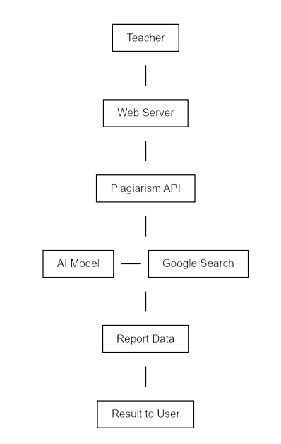
Architecture Diagram

Slide 7
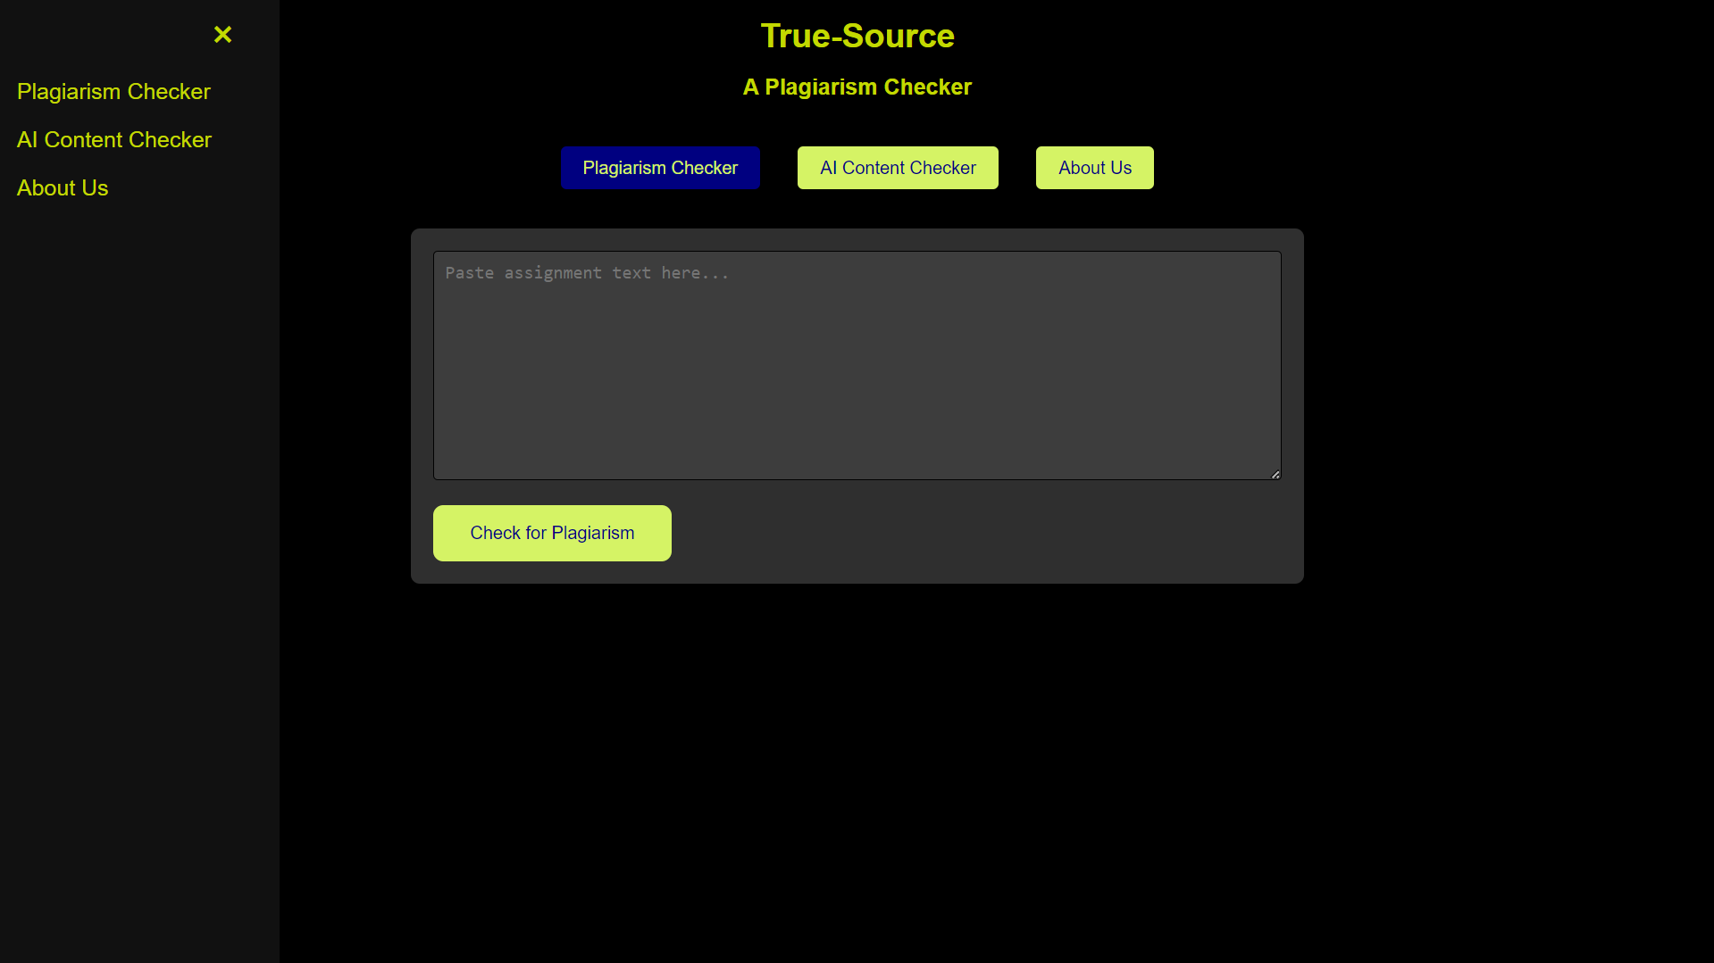
User Interface

Slide 8
Thank you

